Slide 1
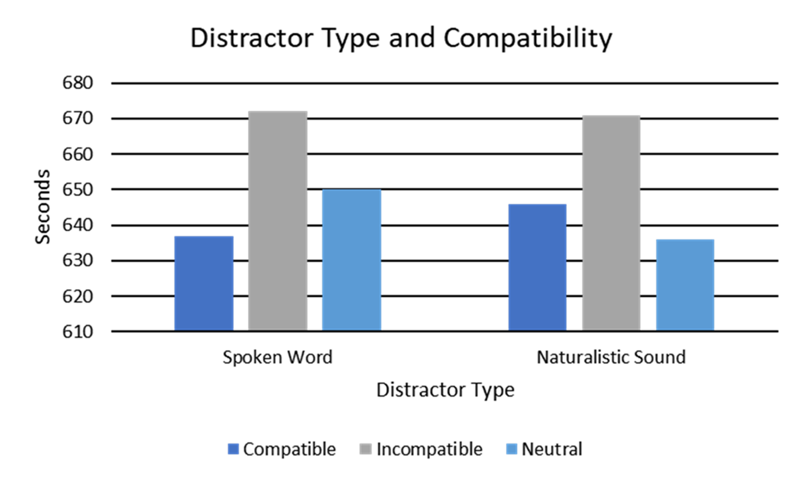
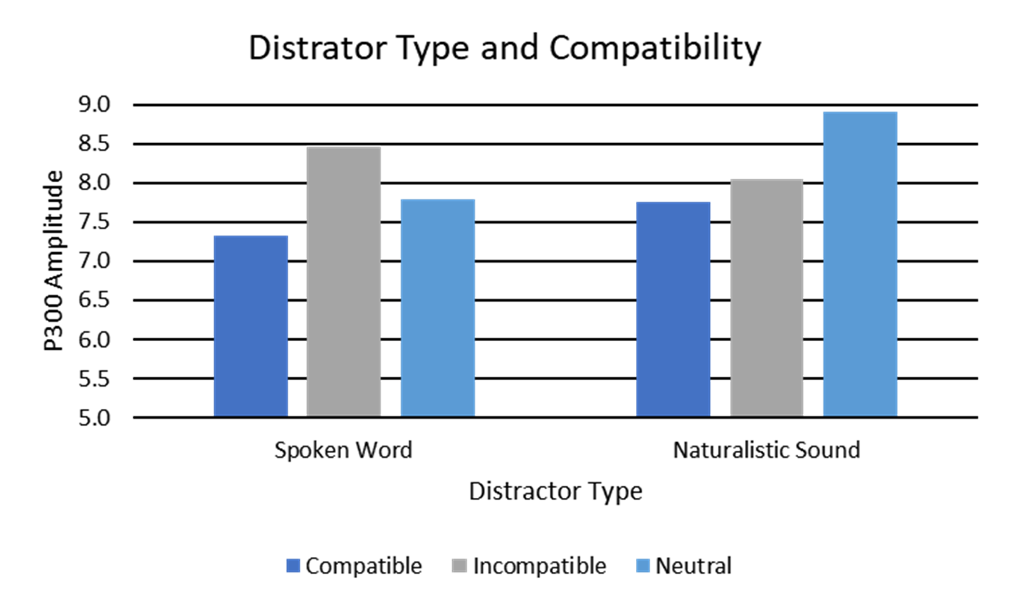
The Processing of Auditory Distractors When Searching for Real Objects
Eliah Anderson
Supervised by Dr. Donald Tellinghuisen of the Calvin Psychology Department
Project Hypothesis
Our study tested the effect of different types of auditory distractors to visual processing. We predicted that auditory distractors incompatible with a search target would be more distracting. Additionally, we tested an exploratory hypothesis that there would be hemispheric processing differences.
Background
Attention research has proposed inconsistent findings about multimodal processing. Past studies by Lavie and colleagues have found that high visual load impairs an individual's ability to hear sounds (i.e. inattentional deafness). Yet, a study by Tellinghuisen and colleagues suggests that inattentional deafness is dependent on the relatedness of the auditory distractor to the visual search target. Thus, this study proposed that individuals do process auditory information with high visual load and that the semantic meaning of the distractor impacts the visual processing capabilities.
Key Findings
As predicted, incompatible distractors were more distracting as they had longer reaction times (p<.001) and a higher P300 amplitude (p=.023)
Hemisphere differences (p=0.59) and distractor type (p=.065) were found to be insignificant though perhaps they would have been significant in a larger sample
Reaction Time Data
P300 Data
Methods
Participants (N=29) engaged in a visual search task to identify either a dog or a car from an array of black and white images. While doing so, the participants heard different types of auditory distractors that varied in compatibility (compatible, incompatible, or neutral), and type (word or non-word). We measured reation time and response accuracy using computer software and the amplitude of the P300 wave from an Event Related Potential using EEG trials.
Sources and Acknowledgements
Macdonald, J. S., & Lavie, N. (2011). Visual perceptual load induces inattentional deafness. Attention Perception Psychophysics, 73, 1780-1789.
Tellinghuisen, D.J., Cohen, A.J., Cooper, N.J. (2016). Now hear this: Inattentional deafness depends on task relatedness. Attention Perception Psychophysics, 78, 2527-2546

